Slide 1

TEAM DETAILS :
Title: CUSTOM CREATIONS HUB
Names: ANISHA N/211423104042,
ANILITTY LD/211423104040
Batch Number: A16 Domain: FULL STACK DEVELOPMENT
Date: 29/10/2025 COORDINATOR NAME & DESTINATION
Dr. KAVITHA SUBRAMANI ME., Ph.D.,
PROFESSOR

Slide 2
AGENDA
Introduction to Custom Creations Hub
Overview of a creative web platform connecting users with custom product designers and makers for personalized creations.
Problem Identification
Challenges faced by users in finding trusted creators and managing personalized orders through a unified platform.
Proposed System – Custom Creations Hub
A Firebase-based web solution offering user registration, product display, and request management with role-based access.
Methodology and Technologies Used
Developed using React.js and Tailwind CSS for frontend, Firebase Firestore for backend, and Firebase Authentication for secure login.
Module Overview
Includes Home, Login/Register, Dashboard, Product Showcase, and Contact modules for smooth user experience.
Testing and Evaluation
Functional, validation, and UI responsiveness testing performed using manual verification and Firebase security rules.
Future Enhancements
Integration of payment gateways, live chat between users and creators, and AI-based design recommendations.

Slide 3
ABSTRACT
Custom Creations Hub is a web-based platform that connects users with creative designers and makers who offer personalized products. The system allows users to browse designs, request custom creations, and communicate directly with creators. Built using React.js for the frontend and Firebase Firestore as the backend, it ensures real-time data handling and secure authentication through Firebase Authentication. The project aims to make the process of finding, customizing, and managing creative orders easier, faster, and more organized for both customers and creators.

Slide 4
INTRODUCTION
Web-based platform connecting users with creative designers.
Allows users to explore and request custom-made products.
Built using React.js and Firebase Firestore for real-time data handling.
Provides Firebase Authentication for secure login and access.
Includes pages like Home, Login/Register, Dashboard, and Contact.
Aims to make the customization process simple and user-friendly.

Slide 5
OBJECTIVE
To design and develop a responsive web platform for showcasing and ordering custom-made products.
To connect customers with skilled creators through an organized and user-friendly interface.
To implement Firebase Firestore for real-time data storage and management.
To ensure secure user authentication and role-based access using Firebase Authentication.
To allow users to browse designs, request personalized creations, and track progress.
To maintain smooth navigation and responsive design using React.js and Tailwind CSS.
To simplify the customization process and enhance the creative collaboration experience

Slide 6
LITERATURE REVIEW
Authors & Year | Key Contribution / Summary
Sharma & Gupta (2022) | Developed an e-commerce platform for custom product orders using MERN stack.
Mehta et al. (2023) | Implemented a digital marketplace connecting artisans directly with customers.
Rani & Kumar (2023) | Proposed a web model for personalized gift customization and order tracking
Thomas & Jacob (2024) | Designed a creator–client portal for managing creative product requests.
Chawla et al. (2023) | Studied Firebase Firestore performance for real-time web applications.

Slide 7
LITERATURE REVIEW
Authors & Year Summary | Key Contribution/Summary
Bhattacharya & Das (2022) | Focused on enhancing UI/UX in online customization platforms using React.js.
Patel et al. (2023) | Proposed a role-based authentication system using Firebase Authentication.
Verma & Singh (2024) | Developed an online art showcase with user interaction and feedback modules.
Ramesh et al. (2023) | Introduced an AI-based recommendation system for personalized design suggestions.
Kaur & Nanda (2022) | Analyzed the scalability of serverless Firebase architecture in small-scale businesses.

Slide 8
LITERATURE REVIEW
Authors & Year Summary | Key Contribution/Summary
Menon et al. (2024) | Created a creative hub platform linking freelance creators with clients for commissions.
Priya & Reddy (2023) | Improved security and data validation in Firestore-backed web applications.
ohnson & Latha (2024) | Designed a full-stack system integrating Tailwind CSS for responsive design.
Ahmad & Noor (2023) | Implemented real-time order status tracking using Firebase Cloud Functions.
Srinivas et al. (2024) | Presented a centralized digital hub promoting handmade and customized products.

Slide 9
PROBLEM STATEMENT
Many small businesses and individuals struggle to showcase and sell their custom-made products online due to lack of a dedicated platform.
Existing e-commerce sites charge high commissions and provide limited personalization options for creators.
Customers often find it difficult to connect directly with creators or request customized products easily.
There is no centralized hub where creators can display, sell, and manage their unique handmade or personalized items efficiently.
Hence, there is a need for a user-friendly platform that bridges the gap between creators and customers, enabling smooth custom product creation, ordering, and communication.

Slide 10
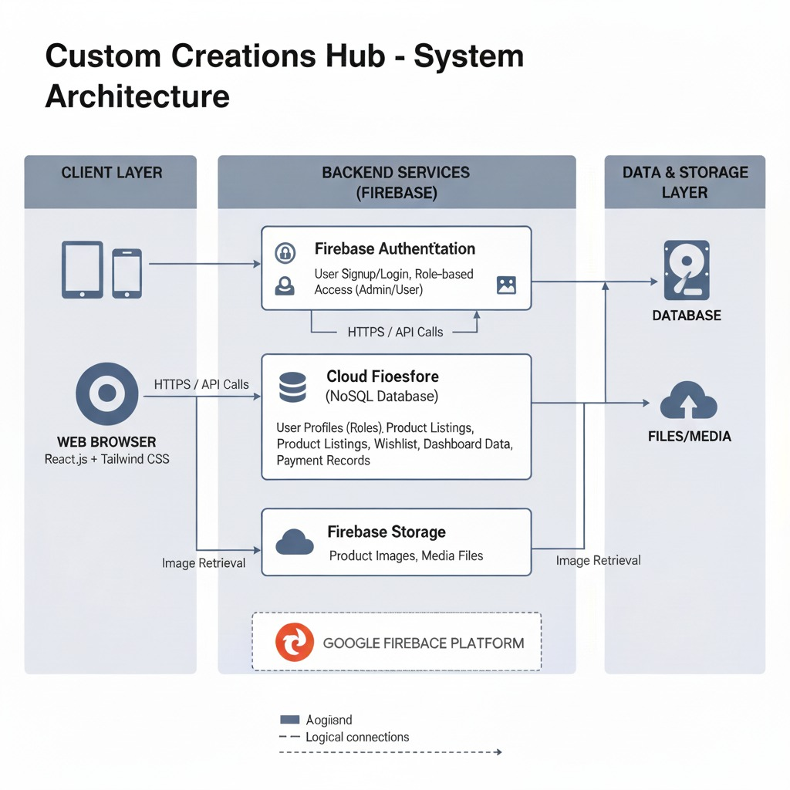
ARCHITECTURE DIAGRAM

Slide 11
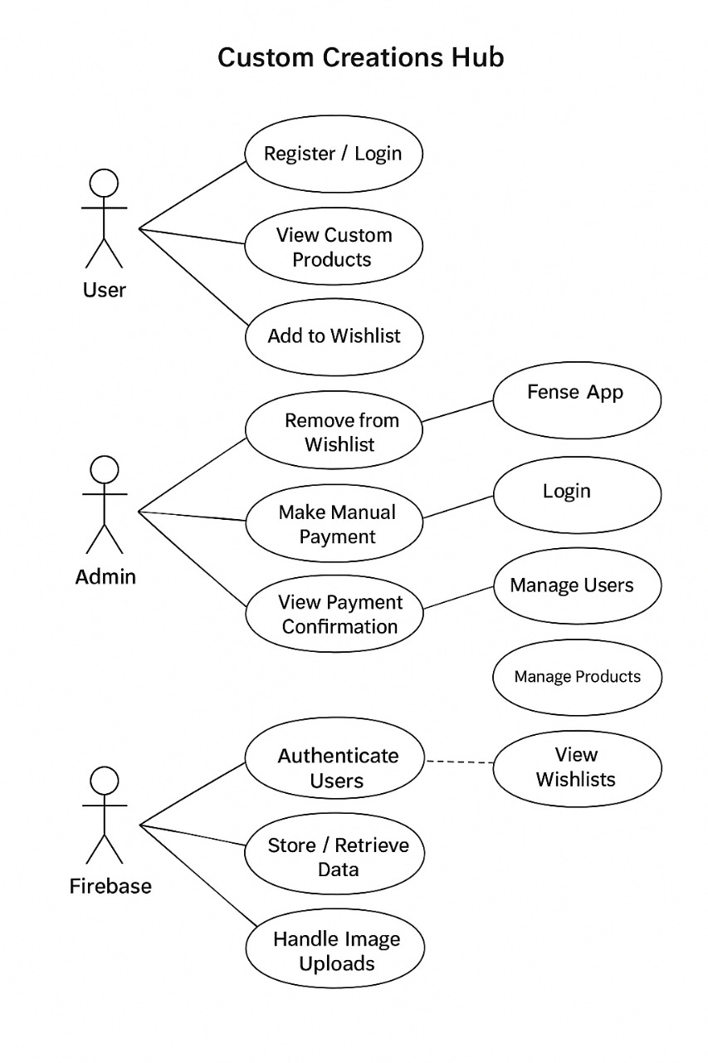
USECASE DIAGRAM

Slide 12
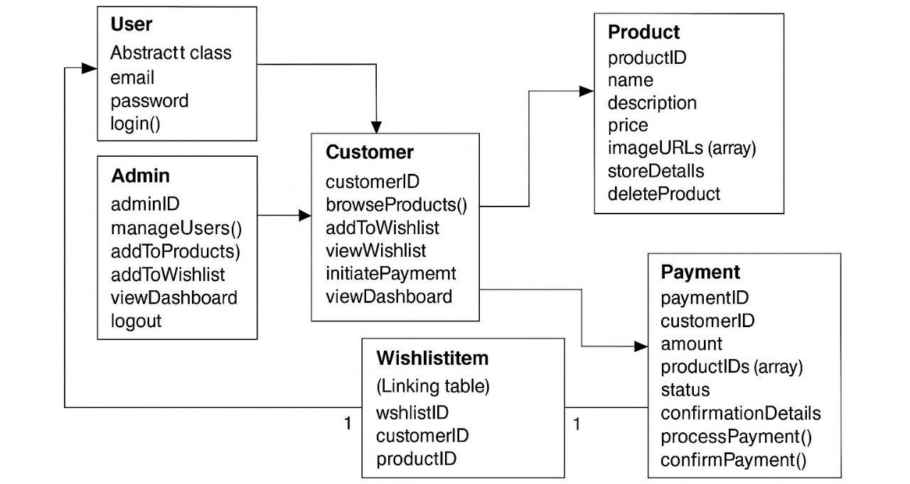
CLASS DIAGRAM

Slide 13
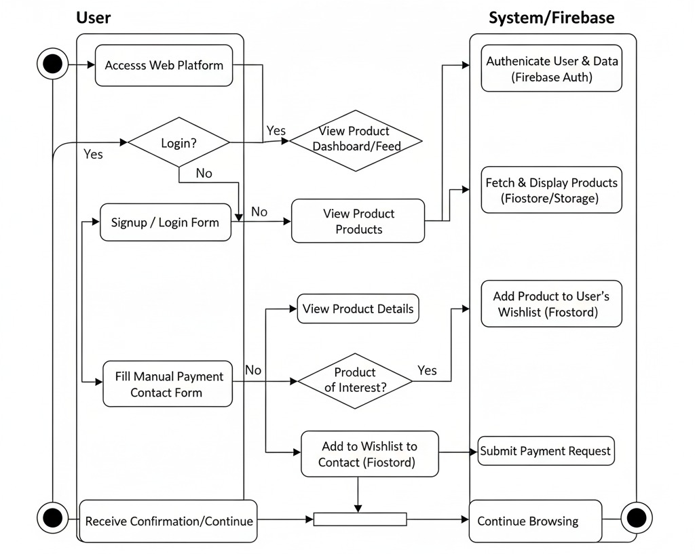
ACTIVITY DIAGRAM

Slide 14
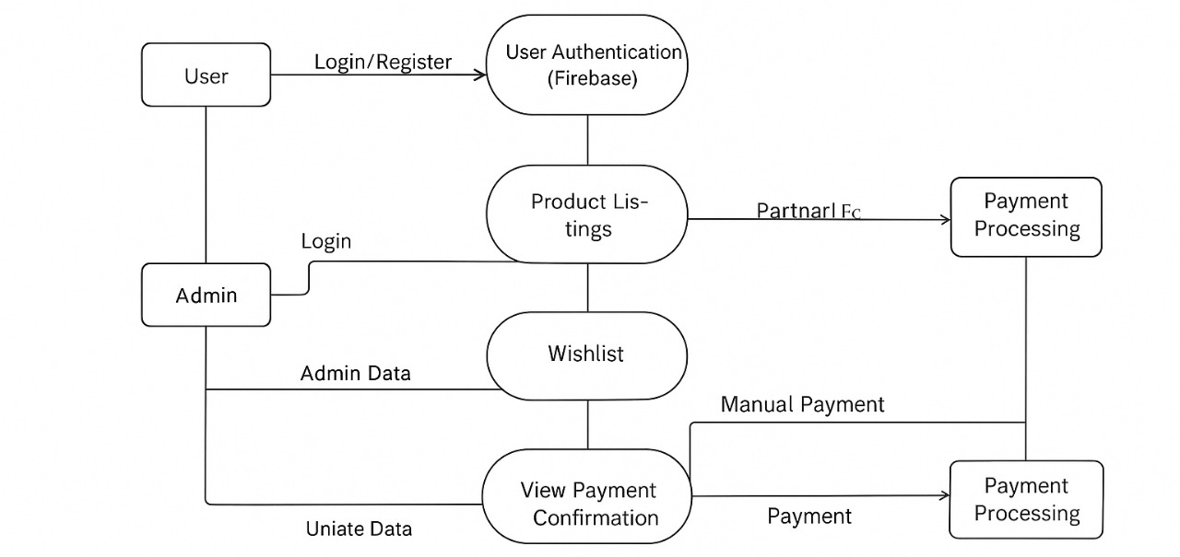
DATA FLOW DIAGRAM

Slide 15
MODULES
User Authentication: Users can register, log in, and manage profiles securely.
Product Browsing & Customization: View available products and customize them with preferred designs.
Wishlist & Orders : Add favorite items to wishlist and place manual orders easily.
Payment Module : Handles secure manual and digital payments.
Admin Dashboard : Admins manage users, orders, and product details with role-based access.
Firestore Database: Stores all user data, product info, and order details in real-time.
Notification System: Sends order updates, payment alerts, and admin messages.

Slide 16
METHODOLOGY
Product Selection & Customization : Users browse available car models or creative items and customize designs (color, accessories, add-ons).
User Authentication & Role Access: Different access levels for Admin, User, and Designer using Firebase Authentication.
Wishlist Management : Users can add, remove, and view favorite customized cars/products for later purchase.
Manual Payment Process: After order confirmation, users can make manual payments or upload proof of transaction.
Firestore Database Integration: All user data, orders, and payment details are securely stored in Firebase Firestore.
Admin Dashboard: Admin monitors users, updates product listings, verifies payments, and manages inventory.
Notification & Updates: Real-time notifications on order status, payment verification, and admin approvals.

Slide 17
TESTING
Verified role-based login (Admin, Client, Consultant).
Checked project posting, proposal, and status updates.
Tested manual payment upload and admin verification.
Ensured chat, file sharing, and communication work properly.
Verified feedback and rating after project completion.
Checked admin dashboard for user, project, and payment control.
Tested system performance – speed, response, and smooth navigation.

Slide 18
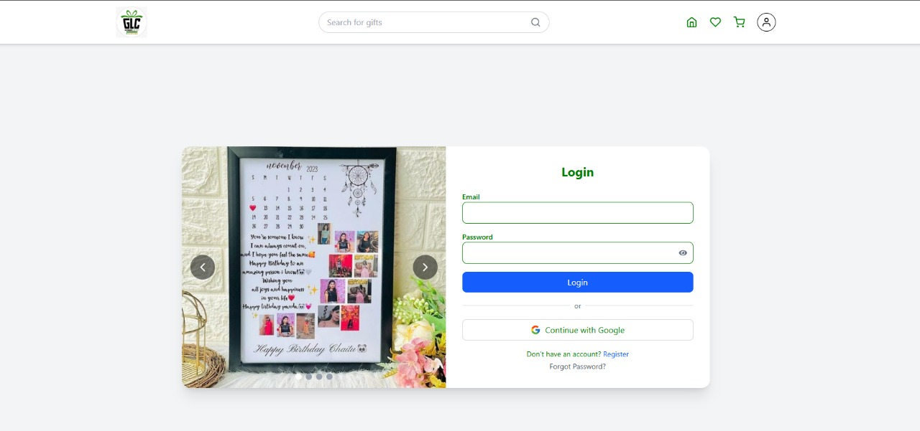
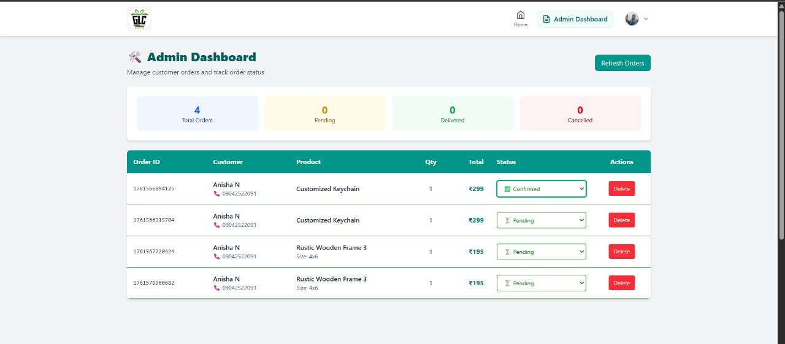
SCREENSHORTS

Slide 19
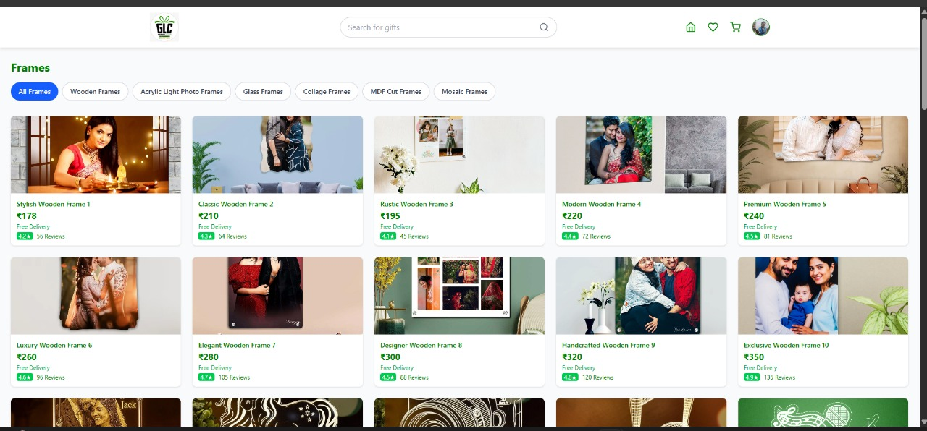
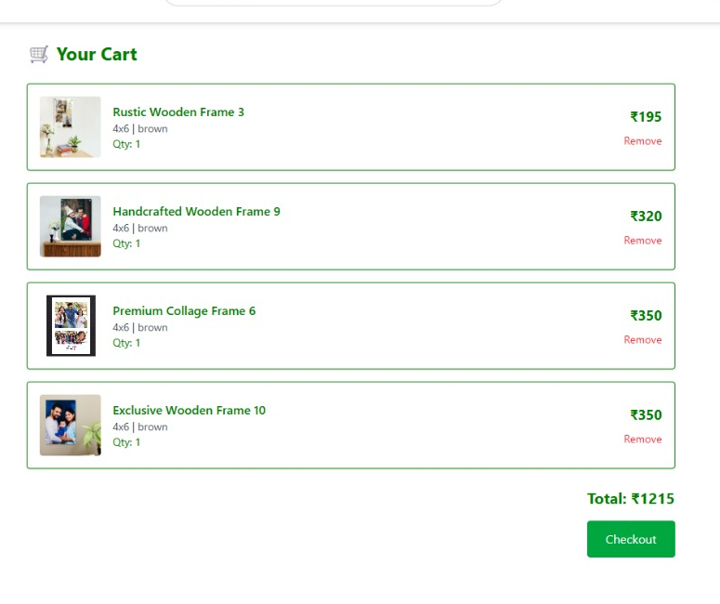
SCREENSHORTS

Slide 20
CONCLUSION
Seamless Customization: Empowers users to design and personalize car models and creative items with ease.
Secure & Scalable System: Built on Firebase Firestore and Authentication, ensuring data safety, role-based access, and real-time updates.
User Convenience: Features like wishlists and manual payment uploads enhance the user experience and flexibility.
Smart Administration: Admins can efficiently manage users, verify payments, and monitor system performance through a dedicated dashboard.
Business & Social Impact: Encourages creativity, transparency, and a digital-first approach for custom design businesses.
Future Scope: Integration of online payments, AI-based design recommendations, and AR previews for real-time customization visualization.

Slide 21
FUTURE WORK
AI-Driven Customization: Integrate AI to recommend personalized designs, color themes, and layouts based on user preferences and trends.
Augmented Reality (AR) Preview: Allow users to visualize customized products in real-time using AR for a more interactive shopping experience.
Online Payment Gateway: Add secure online payment options like UPI, debit/credit cards, and wallets for seamless transactions.
Mobile Application: Launch a mobile-friendly app to let users browse, customize, and place orders anytime, anywhere.
Cloud Scalability: Migrate to scalable cloud infrastructure to handle growing data, user traffic, and media efficiently.
Vendor Collaboration: Enable local artisans or vendors to showcase and sell their creative works directly on the platform.

Slide 22
REFERENCES
Kaur, M., & Saini, M. (2023). Role of Artificial Intelligence in Cyberbullying and Cyberhate Detection. IEEE Access.
Ambareen, K. (2023). A Survey of Cyberbullying Detection and Performance: Its Impact in Social Media Using Artificial Intelligence.
Usmaan Ali, M. (2024). Detection of Cyberbullying on Social Media Platforms Using Machine Learning.
Dave, P., Yuan, X., Siddidu, M., & Roy, K. (2024). Detection of Cyberbullying in GIF Using AI.
Balakrishnan, V., & Kiaty, M. (2023). Cyberbullying Detection and Machine Learning: A Systematic Literature Review.
Fortuna, P., & Nunes, S. (2018). A survey on automatic detection of hate speech in text. ACM Computing Surveys (CSUR), 51(4), Article 85.
Al-Garadi, M. A., Varathan, K. D., & Ravana, S. D. (2016). Cybercrime detection in online communications: The experimental case of cyberbullying detection in Twitt
Rosa, H., Pereira, N., Ribeiro, R., Ferreira, P. C., Carvalho, J. P., Oliveira, S., & Coheur, L. (2019). Automatic cyberbullying detection: A systematic review. Computers in Human Behavior Reports, 1, 100008.
Chatzakou, D., Kourtellis, N., Blackburn, J., De Cristofaro, E., Stringhini, G., & Vakali, A. (2019). Detecting cyberbullying and cyberaggression in social media. ACM Transactions on the Web (TWEB), 13(3), 1–51.
Nandhini, B. S., & Sheeba, J. I. (2015). Cyberbullying detection and prevention: A survey. International Journal of Pure and Applied Mathematics, 101(1), 45–52.

Slide 23
Zhang, Z., Robinson, D., & Tepper, J. (2018). Detecting hate speech on Twitter using a convolution-GRU based deep neural network. In ESWC.
Saha, S. K., Mathew, B., Goyal, P., & Mukherjee, A. (2021). HateMonitors: A Real-Time Hate Speech Detection Framework Using Multilingual Transformer Models. IEEE Access, 9, 141178–141190.
Dadvar, M., Trieschnigg, D., & de Jong, F. (2019). Improving cyberbullying detection with user context. Information Processing & Management, 56(3), 548–559.
Ptaszynski, M., Dybala, P., Matsuba, T., Rzepka, R., & Araki, K. (2010). Machine learning and affect analysis for cyberbullying detection in social networks. Journal of Artificial Intelligence and Soft Computing Research, 1(2), 65–77.
Dinakar, K., Reichart, R., & Lieberman, H. (2011). Modeling the detection of textual cyberbullying. In The Social Mobile Web (Vol. 11, pp. 11–17).
Nandhini, B. S., & Sheeba, J. I. (2019). Classification of cyberbullying text using supervised machine learning techniques. International Journal of Engineering and Technology (IJET), 7(6), 226–230.
Xu, J., Jun, K., Zhu, X., & Bellmore, A. (2012). Learning from bullying traces in social media. In NAACL-HLT.
Salawu, S., He, Y., & Lumsden, J. (2020). Approaches to automated detection of cyberbullying: A survey. IEEE Transactions on Affective Computing, 11(1), 3–24.
Choudhary, R., & Bhattacharya, S. (2022). AI-based cyberbullying detection using hybrid neural models. IEEE Access, 10, 67082–67093.
Gao, L., Kuppusamy, K. S., & Raj, R. (2023). Real-time cyberbullying detection on social networks using deep contextual embeddings. IEEE Transactions on Computational Social Systems, 10(5), 1014–1025.

Slide 24
THANK YOU

